Slide 1
Food Delivery System chasing the sun

Slide 2
项目分析幻灯片 2
Catalogue
01
Analysis
The system interface
03
project
02
Improvement
Function introduced
04

Slide 3
项目分析幻灯片 3
Analysis
Market analysis
Requirements
analysis
The database of the take-out project management system is used to store and manage orders, timely delivery and other relevant information. The specific data involves user information, merchant information, rider.
The demand for take-out service continues to grow.
Traditional e-commerce companies are increasingly pursuing instant delivery

Slide 4
Function introduced
Introduction to UI
Select the food
Users login
New user registration
Choosing a businessman
Settle the bill

Slide 5
Function introduced
Introduction to merchant interface
Merchant login
Merchant registration
Merchants add dishes

Slide 6
Function introduced
Introduction to distributor interface
Order allocated
Distributor login
New distributor registration

Slide 7
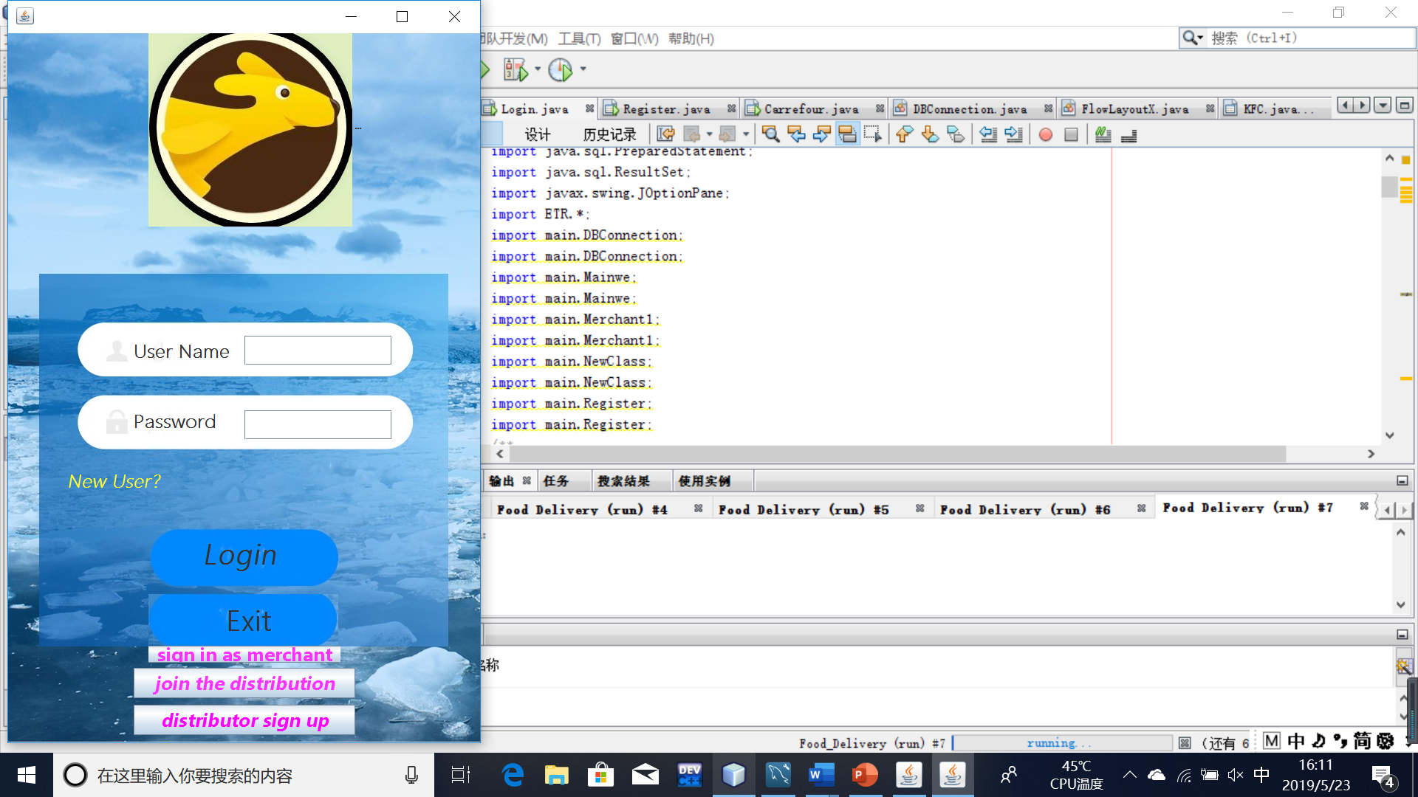
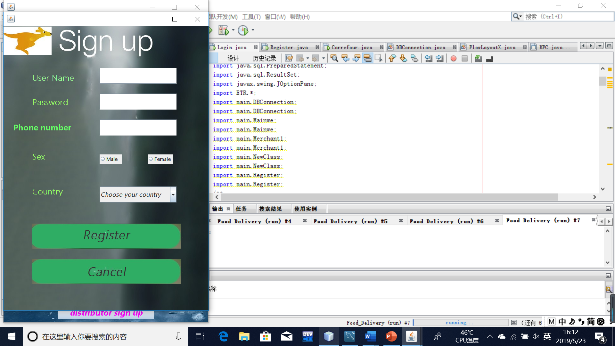
UI
In the database, existing users can log in directly, and new users can log in by registering to write to the database.

Slide 8
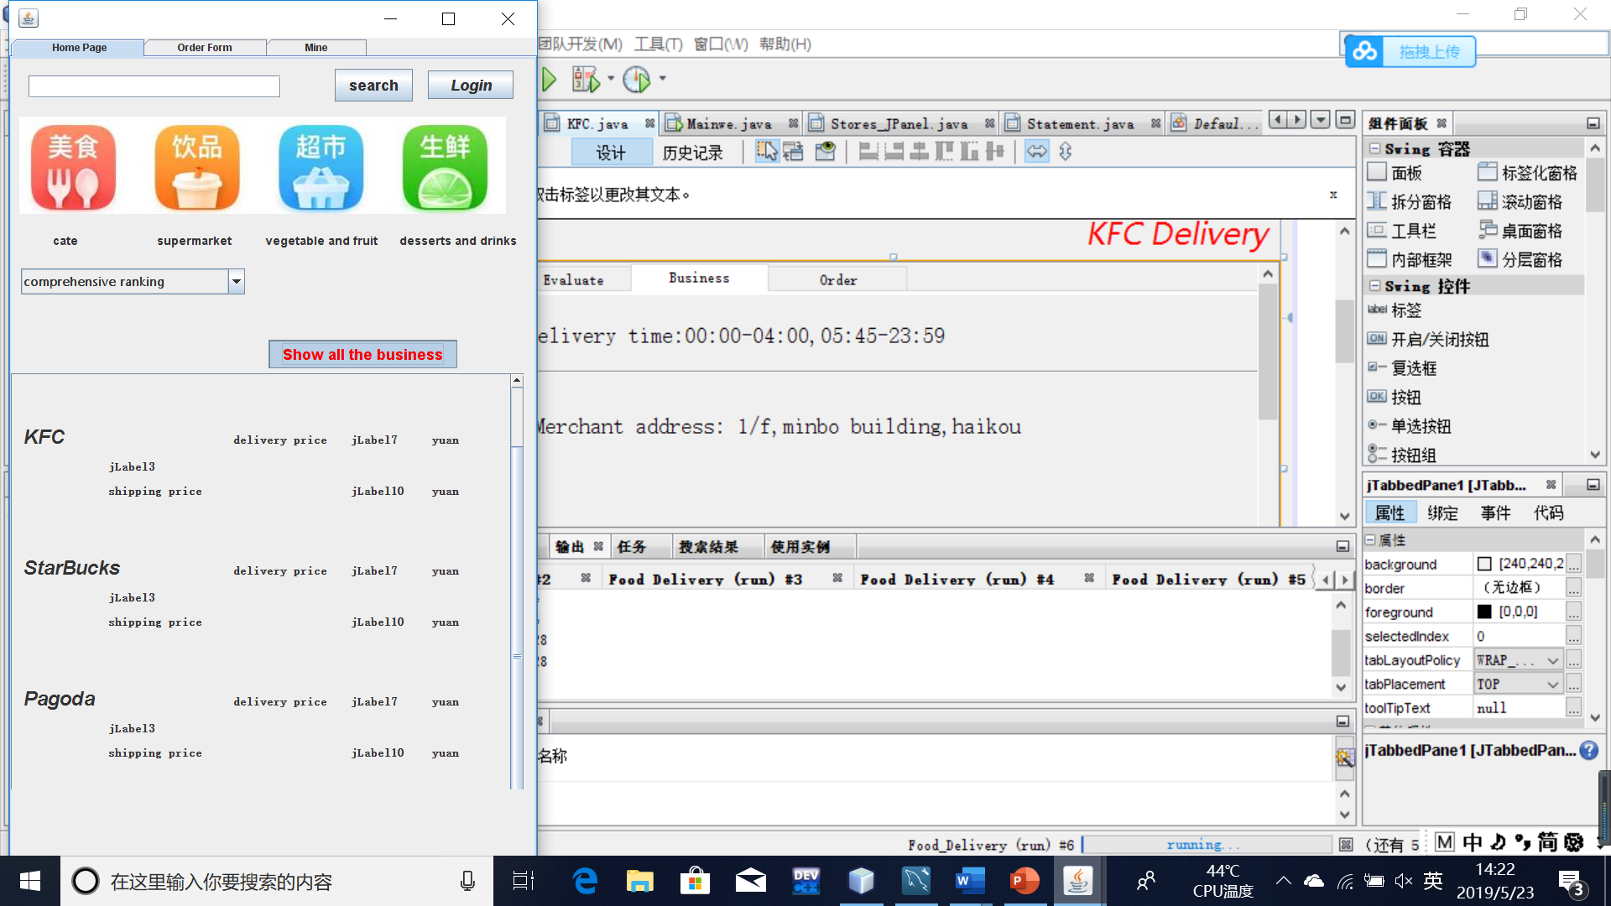

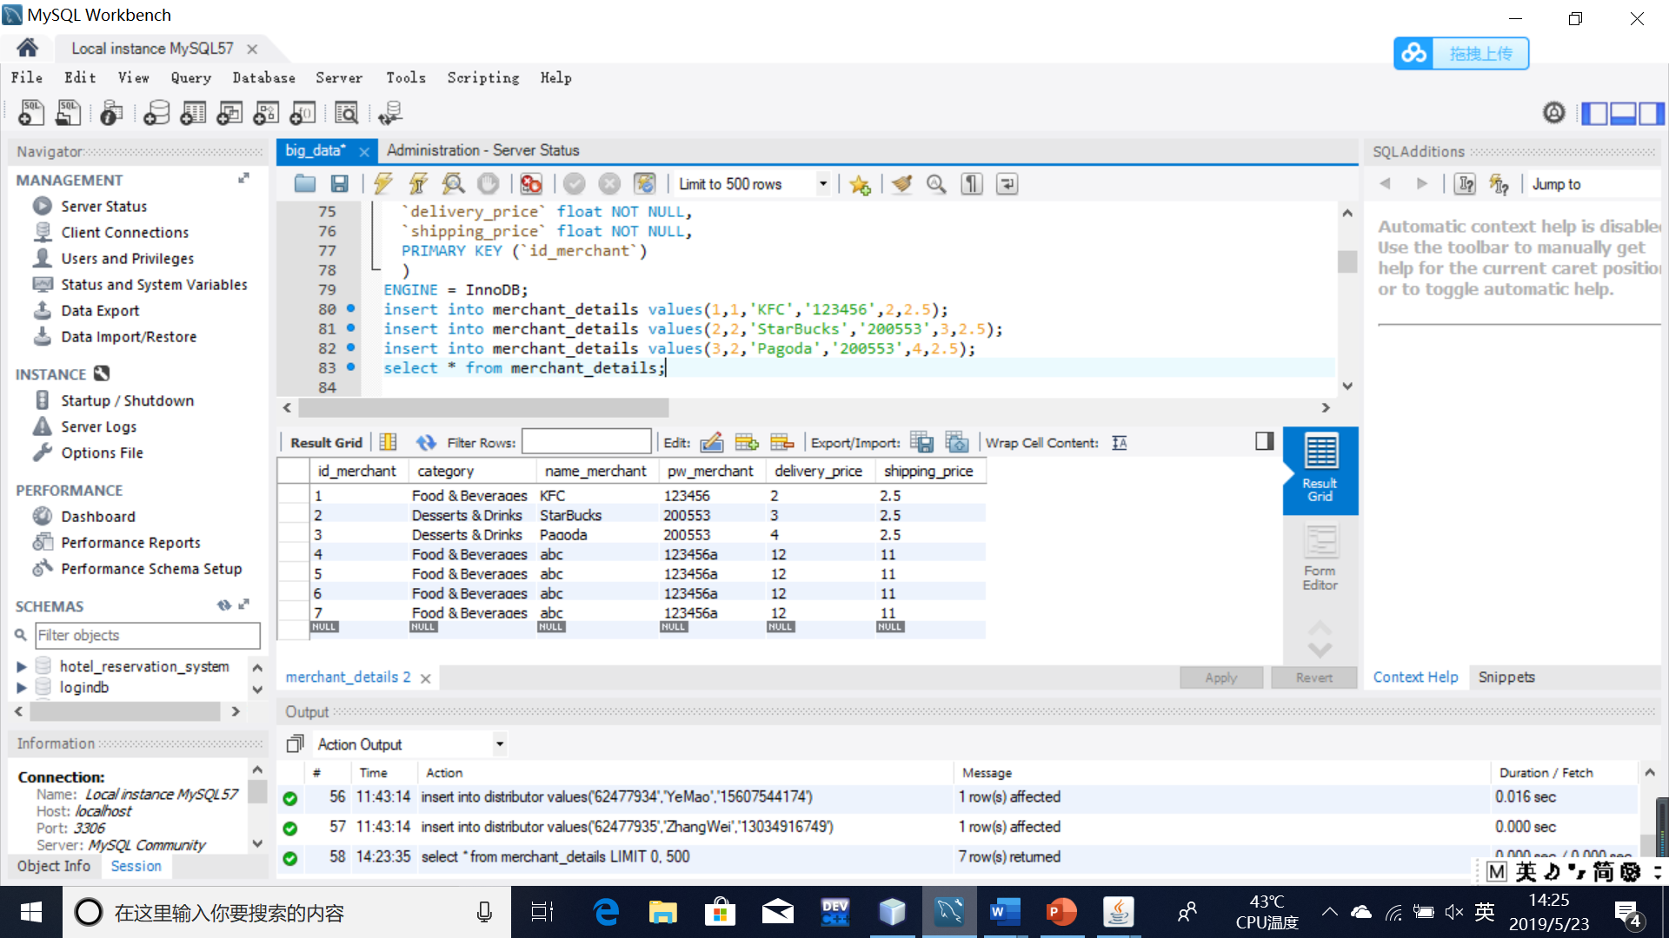
Search service
UI
Click the button:
show recommendation service

Slide 9
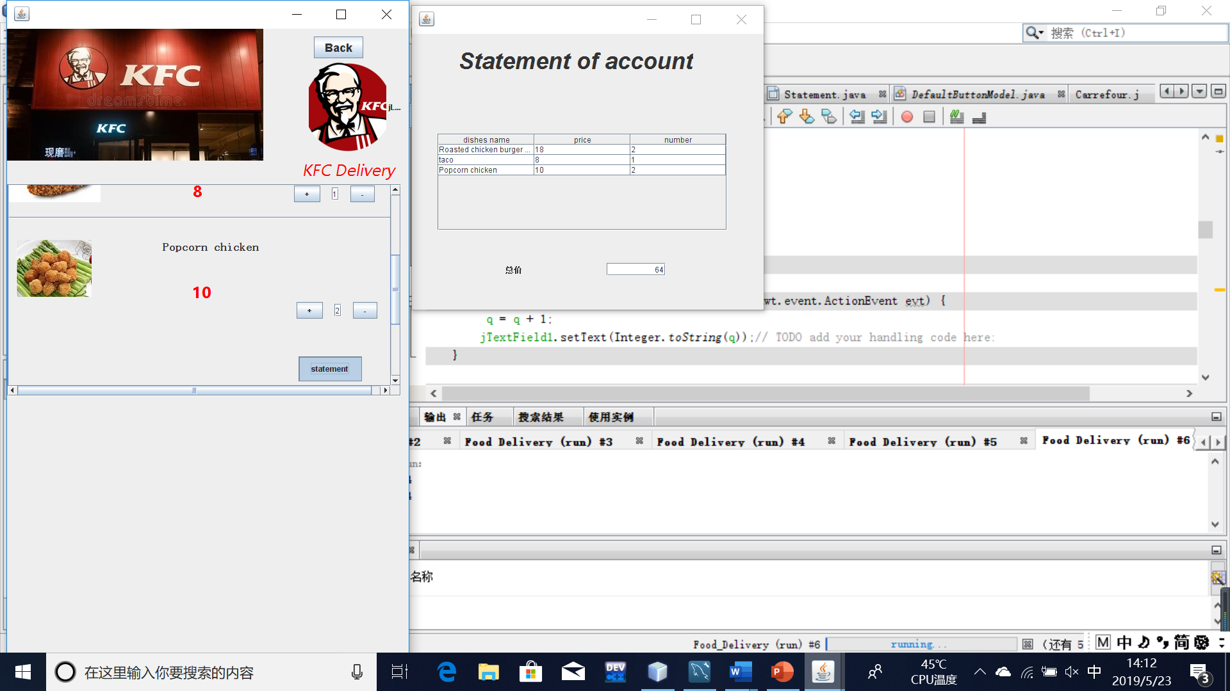
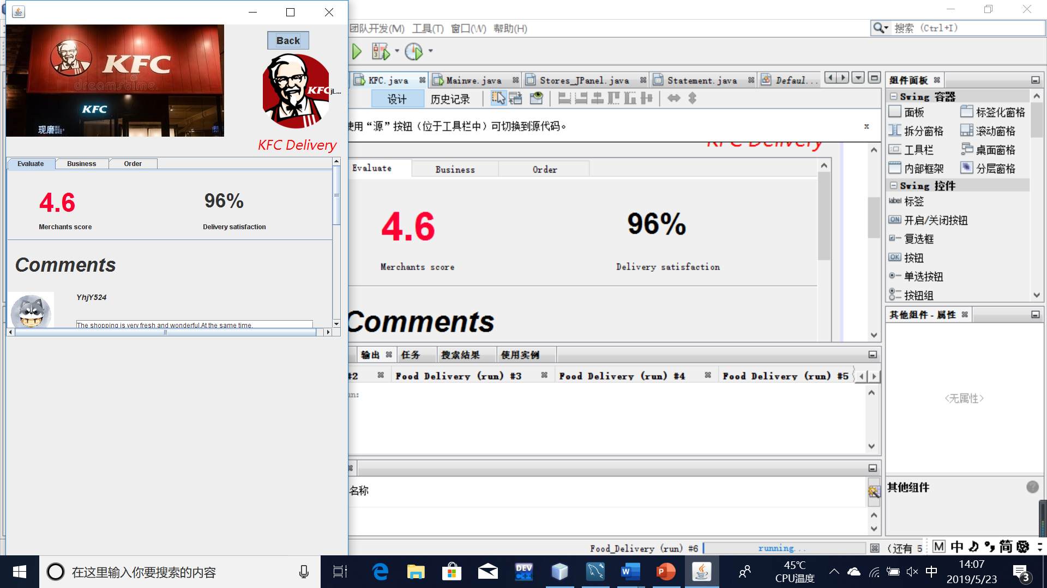
UI

Slide 10
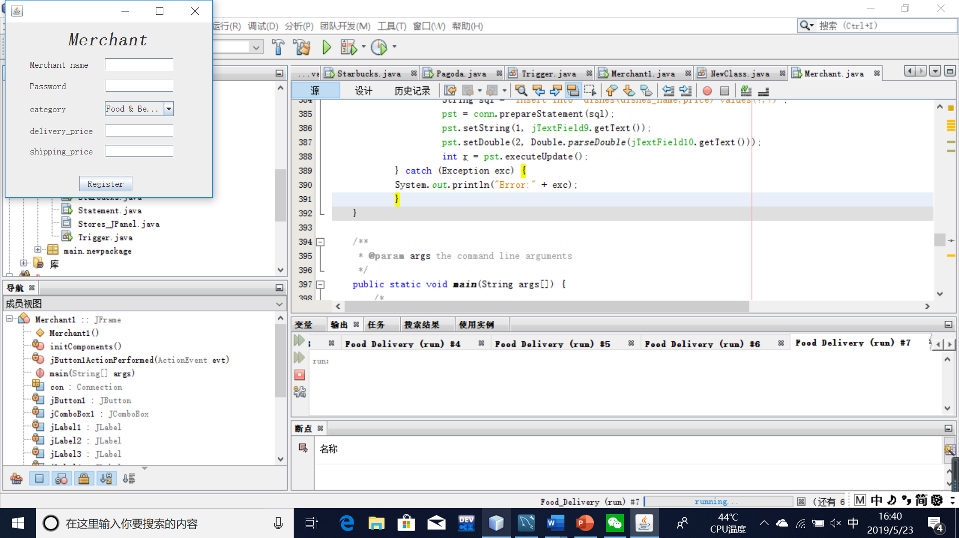
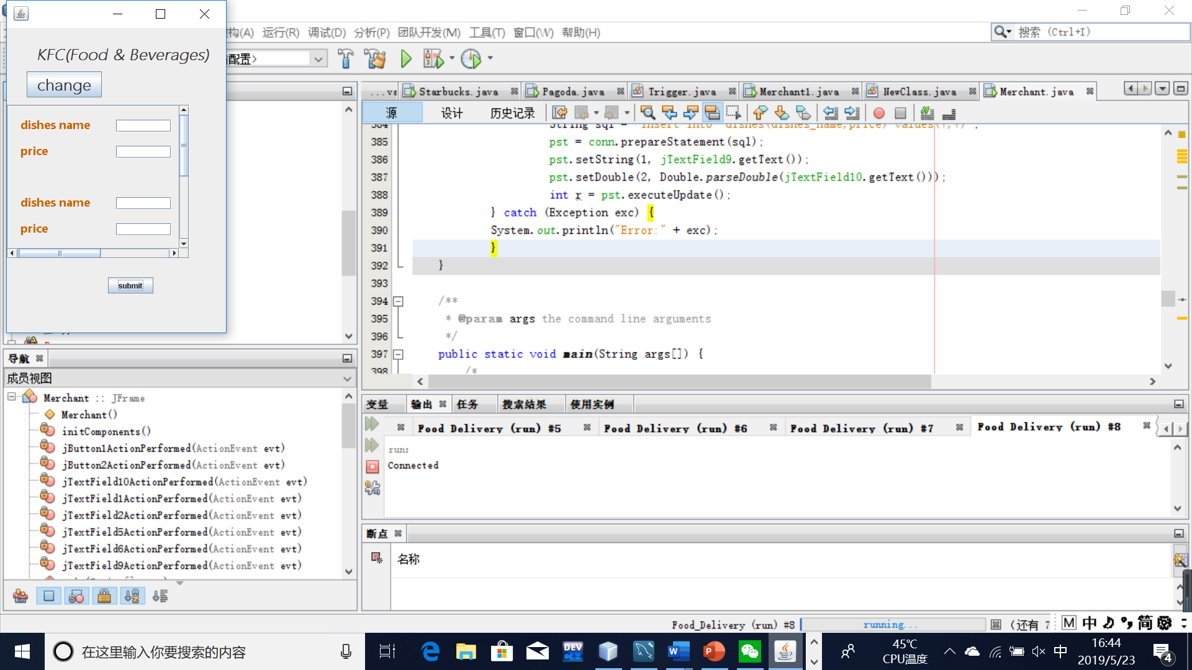
Merchant Interface
Select the registered merchants to add dishes
Register merchants and write them to the database

Slide 11
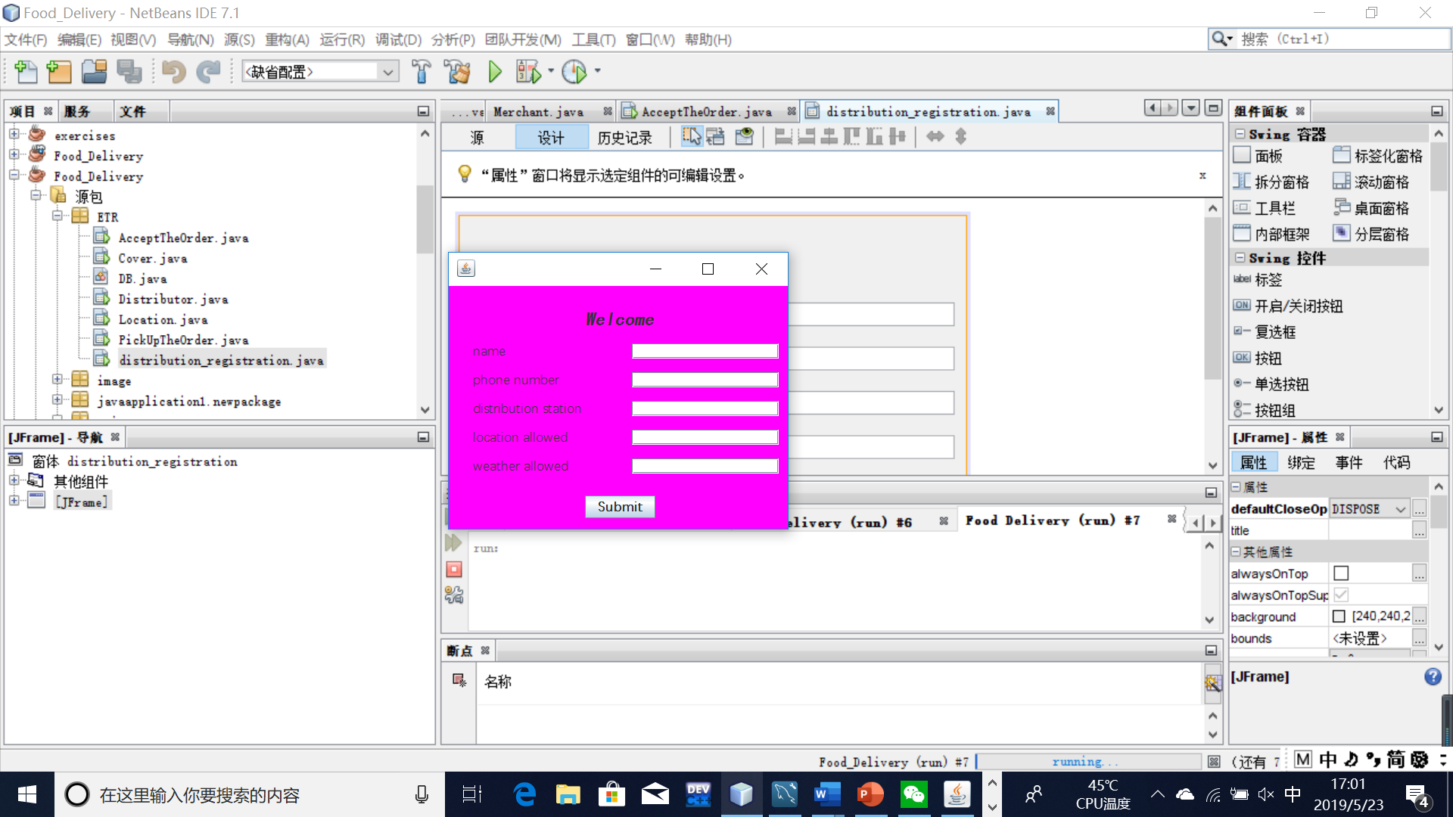
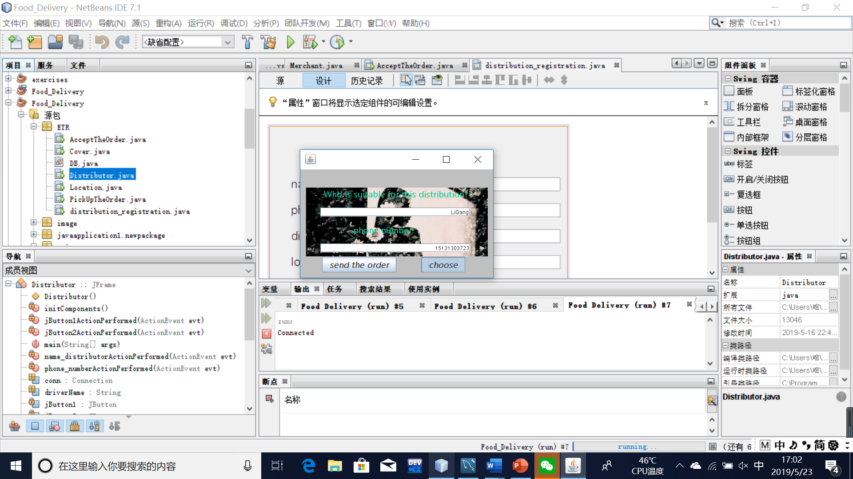
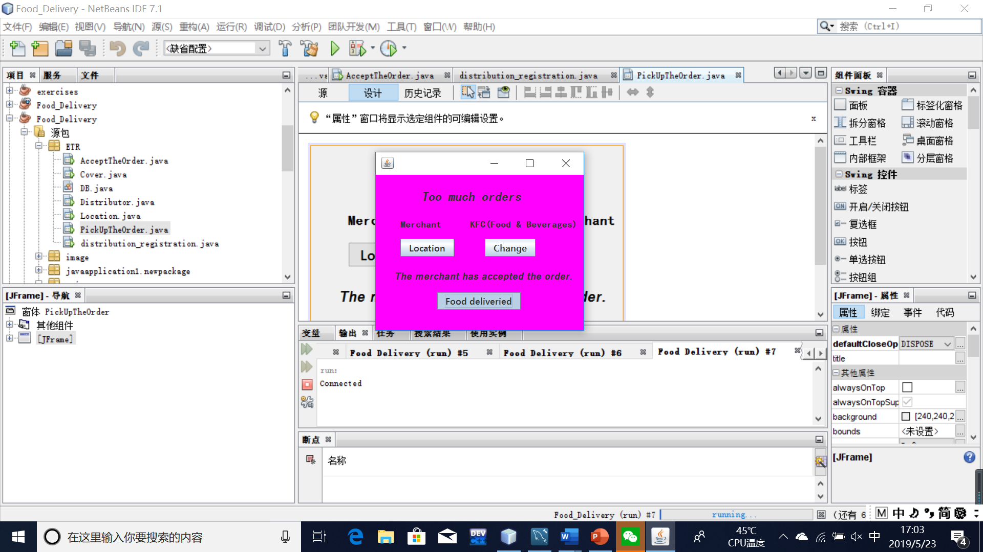
distributor
store delivery information
choose the distributor and allocate an order

Slide 12
Improvement
There are still many things to be improved in this takeout project. We see a lot of room for improvement. If there is a chance, there will be a big change next time.

Slide 13
Thank you

